Slide 1

Measurement Angle project
Instructors
Prof.Dr.Abdelhy mohamed
Dr.Mohamed Abdallah Bahlol
Dr.Mohamed Abdallah Attia
Dr.Nariman Ezzat
Team Members
21231021 | اسلام احمد علي علي
21231012 | احمد محمد العبد ابواليزيد
21231017 | احمد ياسر محمود البنداري
21231014 | احمد محمود حسن عبدالله
21231015 | احمد محمود حسين محمود
21231011 | احمد محمد ابو بكر سليمان
21231005 | احمد رافت سيد صديق
21231009 | احمد عبدالمولى حسين علي
21231019 | ادهم محمد عبالرحيم عوض
21231056 | سيد جمال حسن عويس

Slide 2
Stages
Wiring Diagram
&
Components
Coding
Design and Fabricacation
Calibration

Slide 3
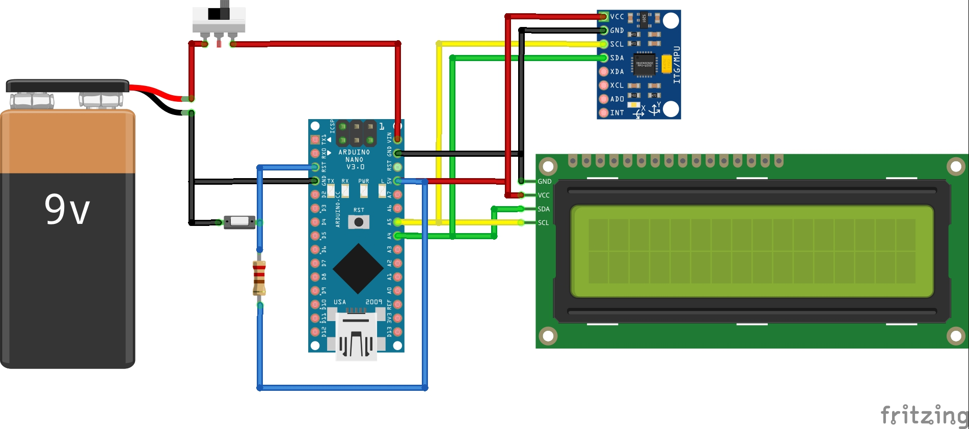
Wiring Digram

Slide 4
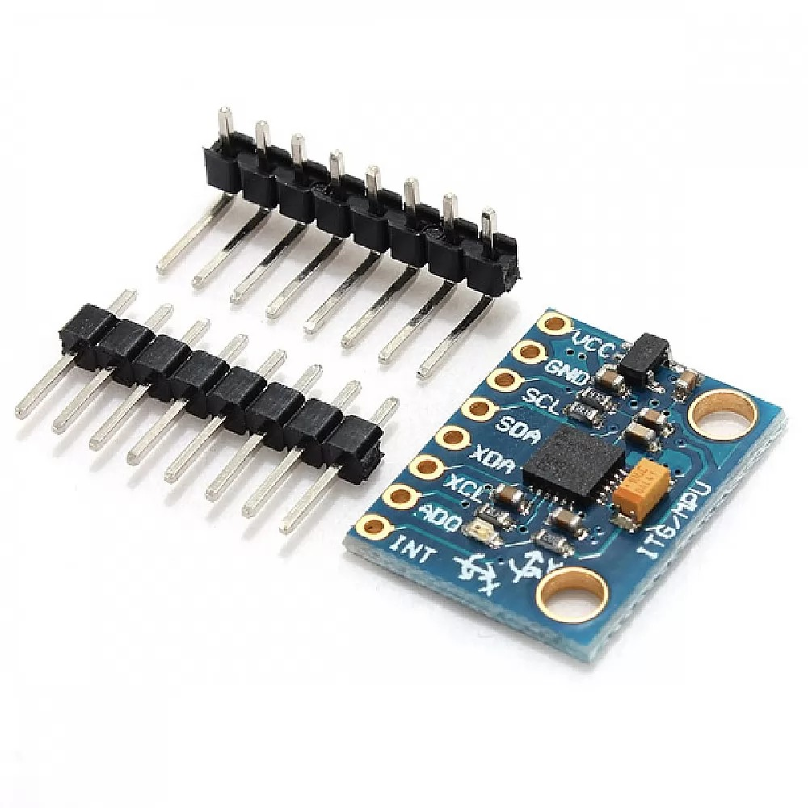
Component
1- Sensing element : MPU-6050 6DOF 3 Axis Gyro With Accelerometer Sensor Module

Slide 5
The MPU-6050 is a commonly used integrated circuit that combines a 3-axis gyroscope and a 3-axis accelerometer in a single package. Here's a brief description of each component:
3-axis gyroscope: A gyroscope measures angular velocity, which is the rate of change of angular position over time. In the case of the MPU-6050, the gyroscope measures angular velocity in three axes: X, Y, and Z. This information can be used to track the orientation or movement of an object, such as a drone or a gaming controller.
3-axis accelerometer: An accelerometer measures acceleration, which can be caused by changes in velocity or gravitational forces. In the case of the MPU-6050, the accelerometer measures acceleration in three axes: X, Y, and Z. This information can be used to detect changes in orientation, movement, or vibration of an object.

Slide 6
Gyroscope working is based on The Coriolis Effect

Slide 7
Accelerometer Working is based on the rate of change in capacitance

Slide 8
More Informations about sensor
1- MPU6050 belong to MEMS (Micro-Electro Mechanical System) Family
2- MPU6050 have own Analog to Digital converter
3-MPU6050 transimation the Data by I2C Protocol
4-MPU6050 is an Passive Sensor

Slide 9
Sensor Applications
1- Measuring Angle
2- Self balancing robot
3-Quadcopter drone
4- Inertial measurement units (IMUs)
5- Navigation systems
6- Fitness trackers
7- Robotics

Slide 10
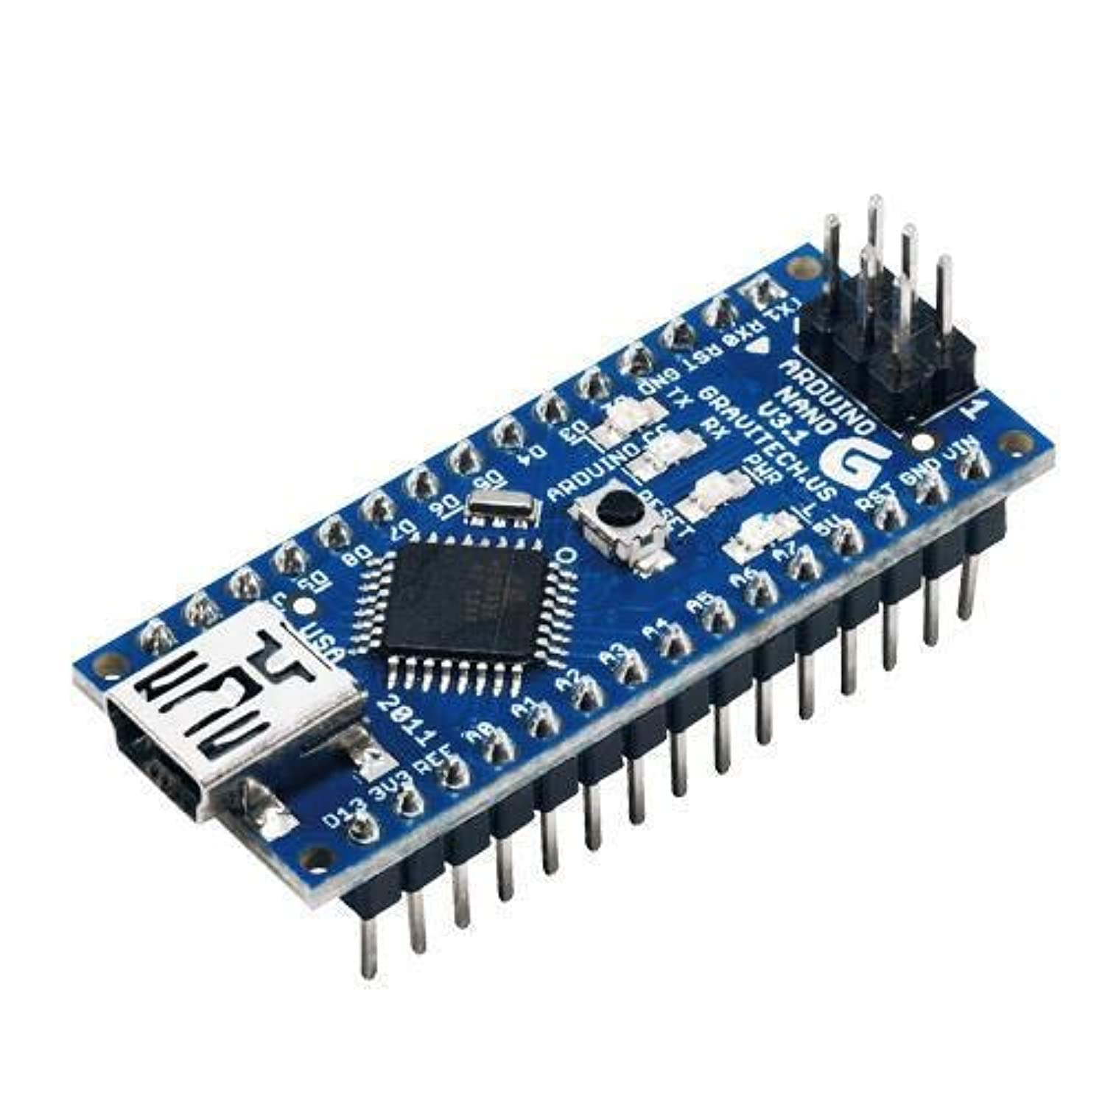
2-Signal processing : Arduino Nano

Slide 11
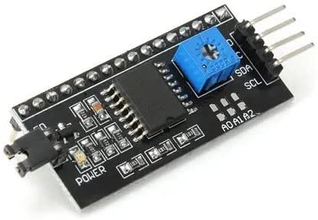
3-Communication Device : I2C LCD Serial Interface Module
A Serial I2C LCD Daughter Board Module is a small circuit board that can be used to connect an LCD display to a microcontroller using the I2C communication protocol. This module typically includes an LCD display, a controller chip, and a serial-to-parallel converter. The I2C interface allows the microcontroller to send commands and data to the LCD display using only two wires, making it a convenient and efficient way to add a display to a project.

Slide 12
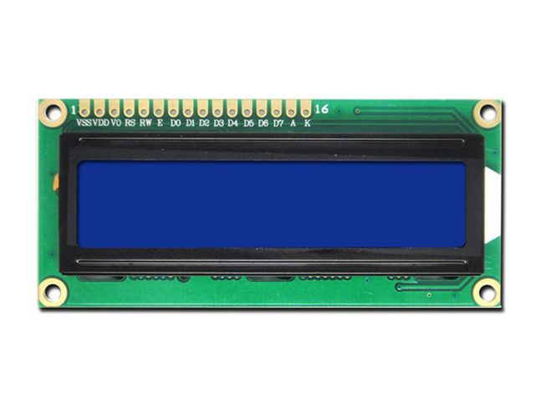
4-Data Presentation : LCD 16 *2

Slide 13
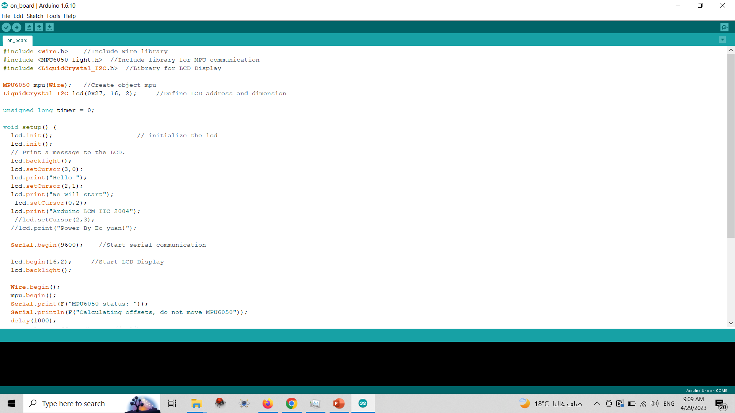
Coding

Slide 14
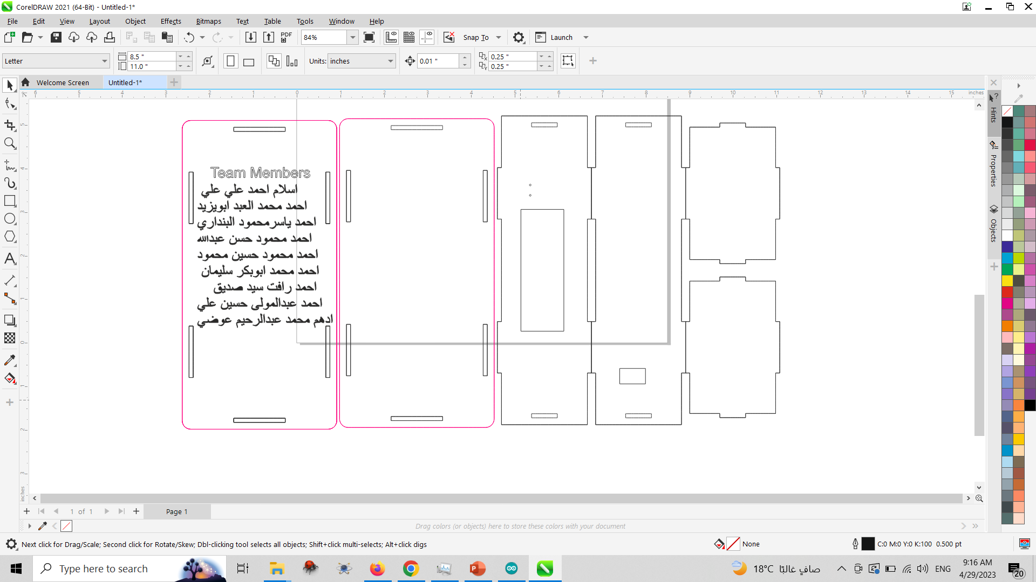
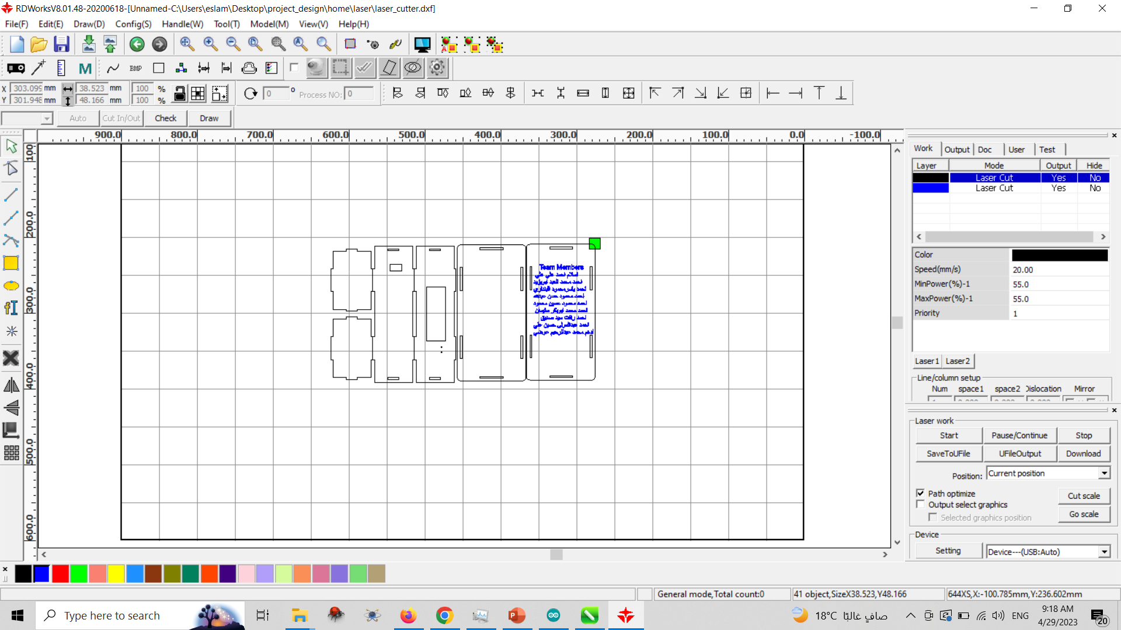
Design and Fabricacation

Slide 15
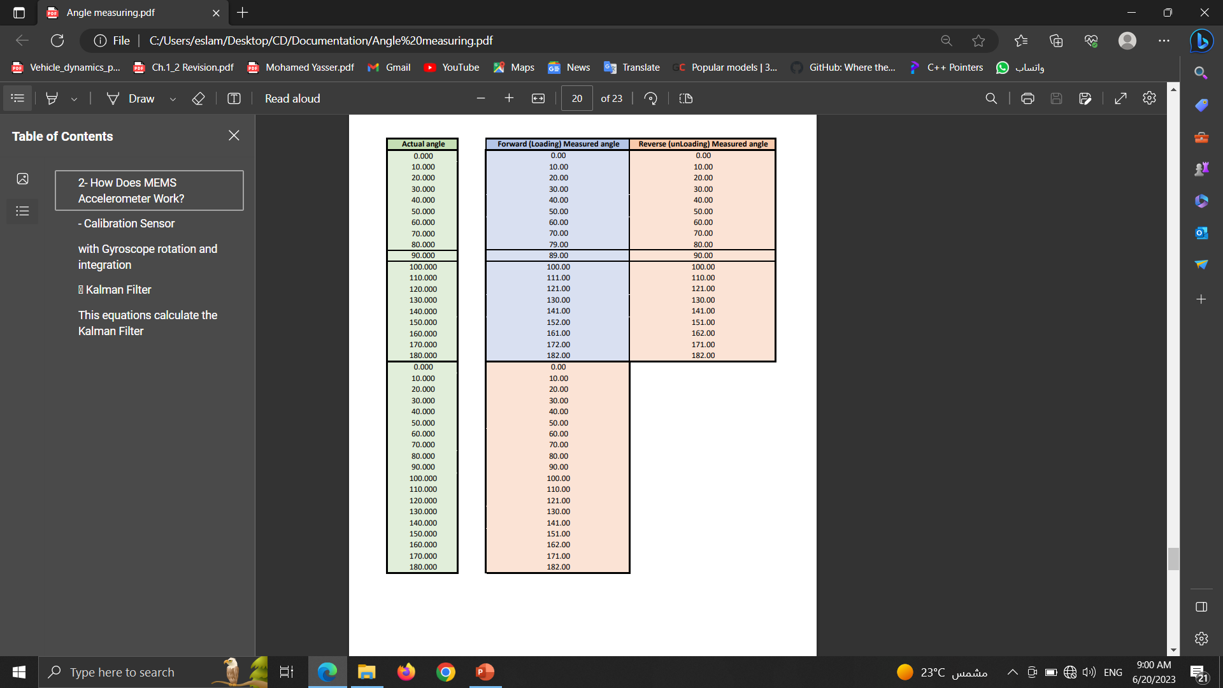
Calibration of device using Excel

Slide 16
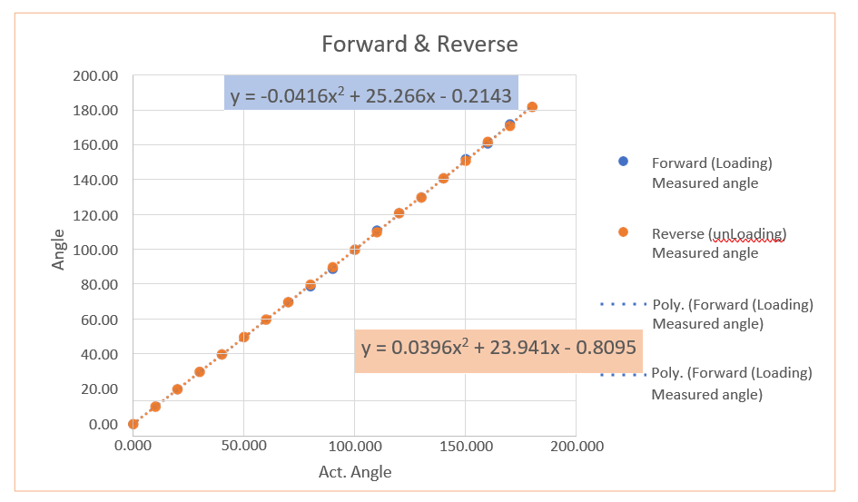

Slide 17
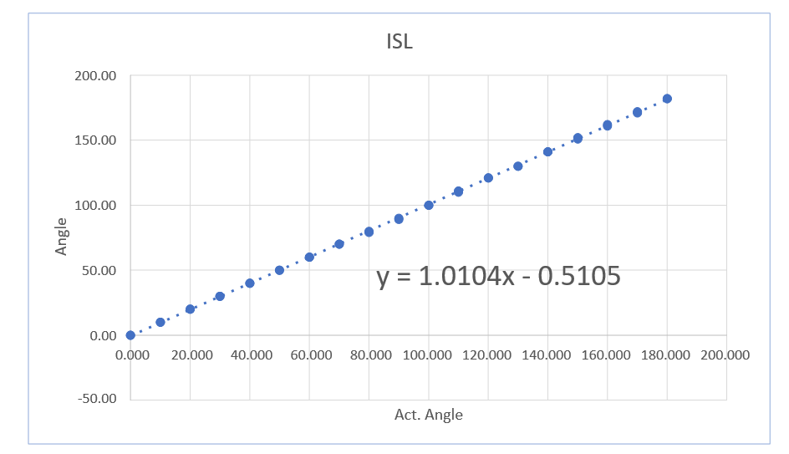

Slide 18
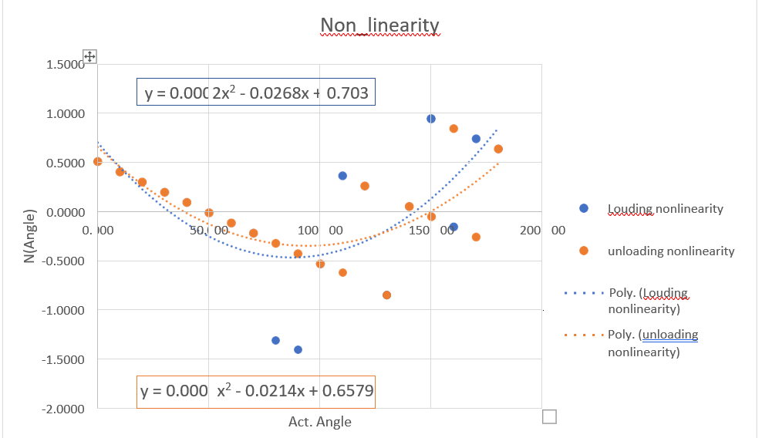

Slide 19
